Slide 1
Recognizing Reader’s Affect Using EEG Data
Kristine Ma. Dominique Kalaw
Researcher
Prof. Ethel Chua Joy Ong
Adviser

Slide 2
Outline of the Presentation
Introduction
Objectives
Significance
Methodology
Current Work

Slide 3
Introduction

Slide 4
INTRO | Emotions
Kleinginna Jr. and Kleinginna (1981) compiled a categorized list of emotion definitions from various emotion theorists and sources of emotion literature.
Emotions play vital roles in rational and intelligent behavior (Bechara et al., 2000; Schwarz, 2000).
There are two general kinds of emotion models:
Categorical models are those that define a number of discrete basic emotions such as Ekman’s 6 basic emotions (happiness, sadness, fear, anger, disgust, surprise) (1972).
Dimensional models describe the components of emotions and are often represented as a two- or three-dimensional space such as Russell’s valence-arousal scale (1980).
Notes:
90+definitions. There is no clear definition to what emotions are.

Slide 5
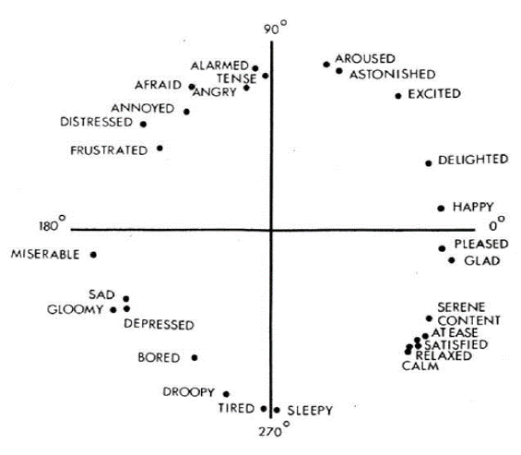
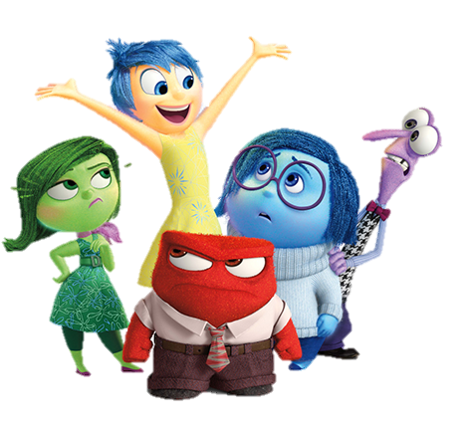
INTRO | Emotions
Source: Walt Disney Pictures / Pixar Animation Studios / Inside Out (2015); Russell (1980)
Notes:
Fun fact: the Inside out director Pete Docter consulted Ekman while they were planning the film. Docter found fear and surprise to be somewhat similar so he merged them.

Slide 6
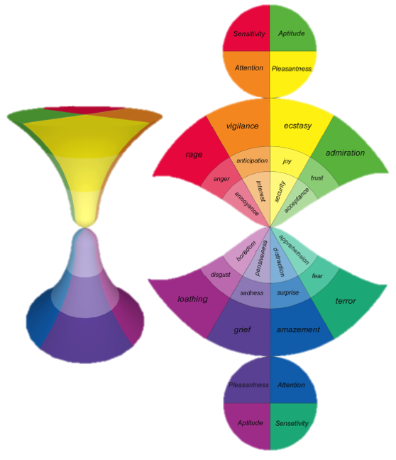
INTRO | Emotions
Pleasantness
how much the user is amused by interaction modalities
Attention
how much the user is interested in interaction contents
Sensitivity
how much the user is comfortable with interaction dynamics
Aptitude
how much the user is condent in interaction benets
Source: Cambria et al. (2012)
Notes:
Refer to p24/25. Because of the difference of the two types of models, Cambria et al proposed a novel biologically-inspired and psychologically-motivated emotion model that combines the two. In this way, they state that their model can potentially describe a full range of emotional experiences. Example: joy+trust+anger = jelousy

Slide 7
INTRO | Emotion Recognition
Affective Computing
COMP | Cannot Express Affect | Can Express Affect
Cannot Perceive Affect | [1] Most computers | [2] Synthesis
Can Perceive Affect | [3] Analysis | [4] A true “personal” and “user-friendly” computer
Relates to, arises from, or influences emotions (Picard, 1997).
Imbue the computer with emotional intelligence*
subset of social intelligence that involves the ability to monitor one's own and others' feelings and emotions, to discriminate among them and to use this information to guide one's thinking and actions (Salovey & Mayer, 1990)
Source: Picard (1997)

Slide 8
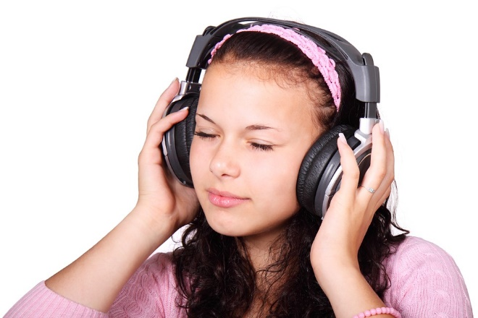
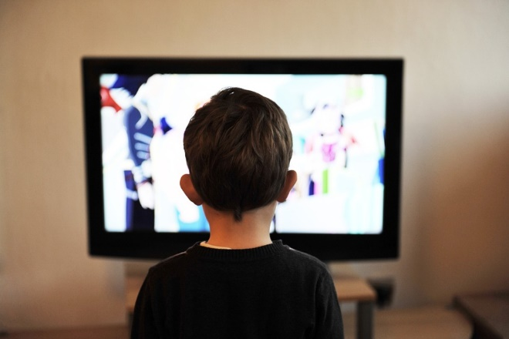


INTRO | Emotion Recognition
Apart from facial and vocal expressions, humans naturally read many physiological signals of emotions (Picard, 2000).
Emotion recognition involves pattern recognition of physiological data, one of which is brainwaves or EEG.
Listening to Music
Lin et al. (2010)
Watching Movies
Nie et al. (2011)
Watching Music Videos
Yazdani et al. (2012)
Answering Math Problems
Azcarraga & Suarez (2012)
Source: Pixabay; TaylorSwiftVEVO (Blank Space)
Notes:
Clammy hands (skin conductance) and fast heart rate can mean that a person is nervous. Please refer to p18 for the summary. All of these studies have employed MLP and SVM

Slide 9
INTRO | Emotion Recognition
Challenges
Factors to consider on gathering good affect data
Emotion model
Accuracy of the data obtained from the sensors due to technical factors
Obtaining the ground truth
Ethical and privacy issues
Subject-elicited vs. event-elicited | Does subject purposefully elicit emotion or is it elicited by a stimulus or situation outside the subject's efforts?
Lab setting vs. real-world | Is subject in a lab or in a special room that is not their usual environment?
Expression vs. feeling | Is the emphasis on external expression or on internal feeling?
Open-recording vs. hidden-recording | Does subject know that anything is being recorded?
Emotion-purpose vs. other-purpose | Does subject know that the experiment is about emotion?
Source: Picard (2000)
Notes:
The experimental set-up is event-elicited, conducted in a lab setting, concerned with feeling, is open-recorded, and is emotion-purpose.

Slide 10
INTRO | EEG
Electroencephalography (EEG) is the recorded electrical activity generated by the brain (Rossetti & Laureys, 2015).
EEG is an effective means of neuro-imaging because it is a noninvasive and safe procedure which can record in milliseconds.
Event-related potentials (ERP) are the EEG signals time-locked to a stimulus which the participant reacts to. The baseline is the time period before the stimulus is presented.

Slide 11
INTRO | EEG
Brainwave Type | Frequency Range | Mental States and Conditions
Delta δ | 0.1Hz to 3Hz | Deep, dreamless sleep, non-REM sleep, unconscious
Theta θ | 4Hz to 7Hz | Intuitive, creative, recall, fantasy, imaginary, dream
Alpha α | 8Hz to 12Hz | Relaxed, but not drowsy, tranquil, conscious
Low Beta β₁ | 12Hz to 15Hz | Formerly SMR (sensorimotor rhythm), relaxed yet focused, integrated
Mid Beta β₂ | 16Hz to 20Hz | Thinking, aware of self & surroundings
High Beta β₃ | 21Hz to 30Hz | Alertness, agitation
Gamma γ | 30Hz to 100Hz | Motor functions, higher mental activity
Source: Brain Wave Signal (EEG) of NeuroSky, Inc. (2009)
Notes:
Refer to p20/21. EEG is generally described in terms of its frequency bands. Each band has a certain frequency range and relates to various brain states. SMR (sensorimotor rhythm) is an EEG frequency band from 12-15 Hz that is associated with an alert, attentive state coupled with calm or silent motor activities.

Slide 12
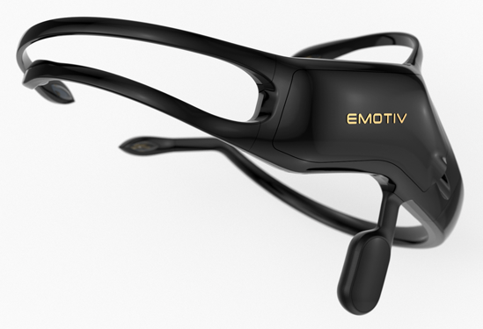
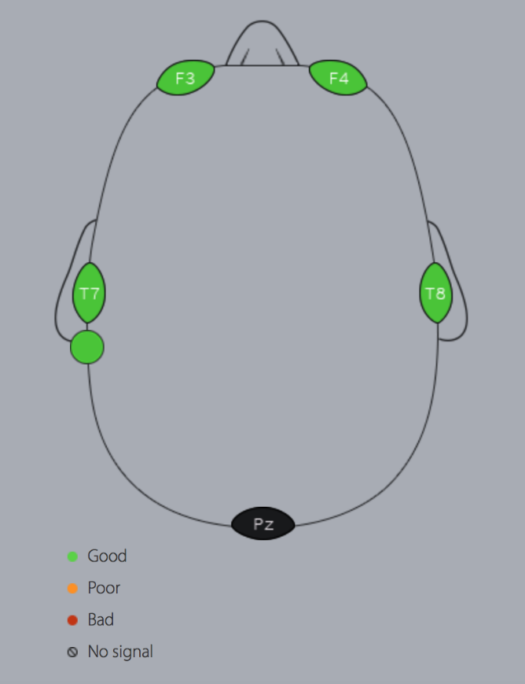
INTRO | EEG
The Emotiv Insight is a 5-channel, wireless EEG headset that records brainwaves.
It is a commercial product marketed worldwide and is designed for everyday use.
It uses a polymer sensor that is safe to use and offers great electrical conductivity with the convenience of a dry sensor.
Source: EMOTIV Inc
Notes:
The EMOTIV Insight was made available for general release in 2015. It is a 5-channel wireless EEG device covering frontal, temporal and parieto-occipital locations around the brain. This device has global recognition for its personal usage such as assessing athletic performance, cognitive training, or health and well-being. It is also backed by man independent researches

Slide 13
INTRO | Reading Fiction
Reading literary texts or fiction is not simply an activity but rather an experience that is never the same from one reading to the next (Tompkins, 1980).
Usually, when one reads non-fiction such as academic texts or news articles, the goal is to be informed. Whereas when one reads fiction such as novels, short stories, or poems, the goal is to be entertained and moved (experience a variety of emotions) (Mar et al., 2011).
Reader-response criticism is a school of literary theory that focuses on the reader, the reading process, and response, rather than the literary text itself. It is said to have started with I.A. Richard's discussion of emotional response (Tompkins, 1980).

Slide 14
INTRO | Reading Fiction
Emotions of Literary Response
Narrative Emotions
Sympathy
Identification
Aesthetic Emotions
Relived Emotions
Empathy*
Remembered Emotions*
Source: Oatley (1995); Mar et al. (2011)
Notes:
Original: Sympathy, Identification, Emotion memories

Slide 15
INTRO | Reading Fiction
Emotions of Literary Response
Evaluative Feelings
Narrative Feelings
Aesthetic Feelings
concerned with the overall enjoyment, pleasure, or satisfaction of reading the text
evoked by events or characters in the fictional world of the text
prompted by the formal (generic, narrative, or stylistic) components of a text
Self-modifying Feelings
restructure the reader's understanding of the textual narrative and, simultaneously, the readers sense of self
Source: Miall & Kuiken (2002)
Notes:
In relation to this research, it is only concerned with the first three. You will notice later on that this classification coincides with the *3rd specific objective

Slide 16
INTRO | Reading Fiction
Miall and Kuiken (1994) observes how foregrounding, or stylistic variation in the text, influences the response of the reader in terms of reading time, strikingness, and affect.
Cupchik et al. (1998) conducted a similar experiment but instead of focusing on what aspects of the texts elicited the emotional response, it is concerned with what type of emotional response the reader evoked.

Slide 17
INTRO | Research Statement
There is no current work that has studied brainwave patterns and their association to affect while a person is reading literary fiction.
EEG
Affect
Fiction
Notes:
There have been studies establishing the association of brainwave patterns and emotions while being engaged in an activity. There have also been empirical works that have established the relation between reading and emotions or emotional response in areas of culture, media, and arts.

Slide 18
Objectives

Slide 19
General Objective
To build an affect model that maps the EEG signals collected from readers (while they are reading stories) to specific emotions.

Slide 20
Specific Objective #1
Objective
Scope and Limitation
To review the approaches, methodologies, and experiments of existing affect detection or recognition studies that uses EEG data;
A review of existing affect detection or recognition studies that uses EEG data.

Slide 21
Specific Objective #2
Objective
Scope and Limitation
To identify the different emotions that can be elicited from the readers as they read the stories;
A review of different emotion models and determine which of them is appropriate for reader affect.

Slide 22
Specific Objective #3
Objective
Scope and Limitation
To determine which elements of a story affect the reader's emotional state;
The study will attempt to determine which element of the story triggered the reader to evoke that emotion.
character traits and behavior
reader's empathy to the character
the story plot or casual chain of story events
lexical choices and sentence structure.

Slide 23
Specific Objective #4
Objective
Scope and Limitation
To build a corpus of EEG signals;
The participants will be people aged 18 and above
They will read pre-selected short stories while an EEG sensor is attached to them
Notes:
Refer to Sec4.2 on p30 for short stories

Slide 24
Specific Objective #5
Objective
Scope and Limitation
To implement machine learning algorithms for classifying the emotion based on the EEG signals;
Weka
Rapidminer

Slide 25
Specific Objective #6
Objective
Scope and Limitation
To define evaluation metrics for assessing the performance of the model;
Supervised ML
Precision
Recall
Accuracy
F-measure
Unsupervised ML
To be determined

Slide 26
Significance

Slide 27
SGFNT | Affective Computing
Explore the feasibility and application of these existing areas on an unexplored domain.
Affective Computing
Wearable computing
Computer Vision
Pattern Recognition
Machine Learning
Digital Signal Processing
Human-Computer Interaction

Slide 28
SGFNT | Methodology & Experiments
Serve as basis and reference for related future studies.
Data Collection
Data Preparation
Preprocessing
Classification
Notes:
Ex. Miall and Kuiken experiment

Slide 29
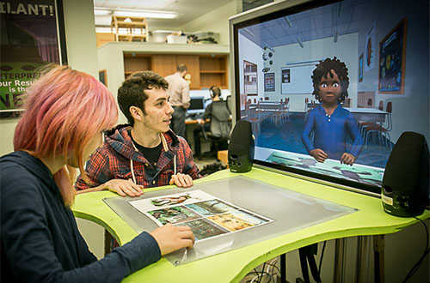
SGFNT | Affect-Related Systems
Results of this study can be further utilized in intelligent tutoring systems (ITS) or embodied conversational agents (ECA).
Source: ArticuLab / Carnegie Mellon University / Project Alex
Notes:
These kinds of systems replicate face-to-face human interactions with, for example, a digital avatar. Since these systems serves as stand-ins for humans, it should at least, on a certain level, feel like having a natural interaction with a human. This is the 4th category in Affective Computing

Slide 30

SGFNT | Beyond Computer Science
The findings of this work may be informative to affective science, psychology, and other related fields.
Source: Open University
Notes:
Emotion detection can also be an indicator for behavior prediction, most especially when monitoring certain emotional states that could lead to potentially harmful or dangerous behaviors.

Slide 31


SGFNT | Beyond Computer Science
Business perspective
By knowing their target audience's likes or dislikes, companies can efficiently create more effective products or services
Consumer perspective
Revamping the rating, reviewing, and recommendation system
Source: Lazada; Amazon
Notes:
So if there is some way to refine the rating and reviewing system to be automatic or semi-automatic and to present the detected emotions in an intuitive and objective manner, then the
consumers could make informed decisions and know that the product or service is truly worth their money. Another example can be considering emotions as tags for content media retrieval such as looking for book recommendations that makes you feel happy.

Slide 32
Methodology

Slide 33
Methodology
 | JAN ’16 | FEB | MAR | APR | MAY | JUN | JUL | AUG | SEP | OCT | NOV | DEC | JAN ‘17 | FEB | MAR | APR
(1) | **** | **** | **** | **--
(2) |  |  | --** | **-- | **--
(3) |  |  |  |  | --** | **** | **-- |  |  |  | --** | *--- | **** | ****
(4) |  |  |  |  |  |  | **** | ***- | -*** | **** |  |  | **** | **** | **--
(5) | --** | **** | **** | **-- | **** | **** | **** | ***- | -*** | **** | **** | *--- | **** | **** | **** | *---
Concept Formulation and Review of Related Literature
Development of Data Collector Tool
Data Collection and Corpus Building
Training and Evaluation
Documentation
Notes:
Refer to page 9

Slide 34
Current Work

Slide 35
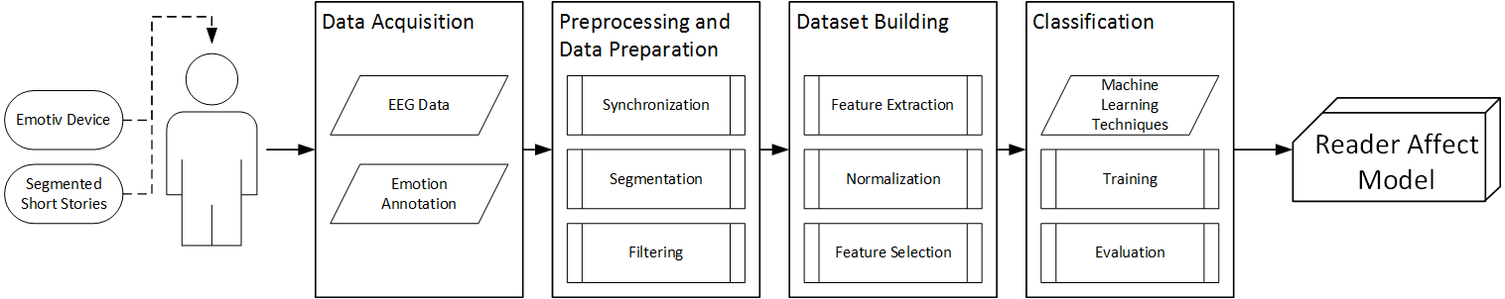
CW | Research Framework
Notes:
Refer to p29. These short stories were recommended by the director of the creative writing department of DLSU (Refer to Sec4.2 on p30 for short stories). The segments were also approved by her.

Slide 36
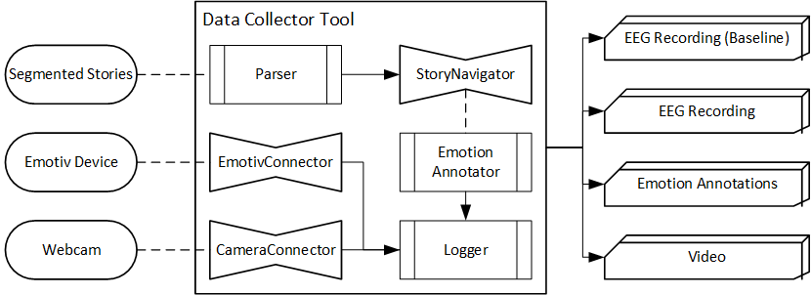
CW | Data Collector Tool
Notes:
Refer to p31. Developed in C#. 3 main module: connector, parser, logger.

Slide 37
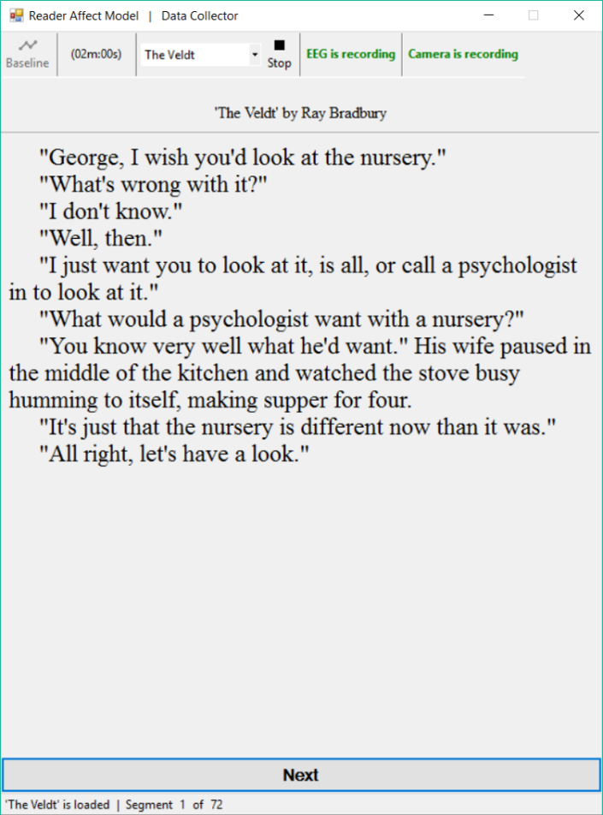
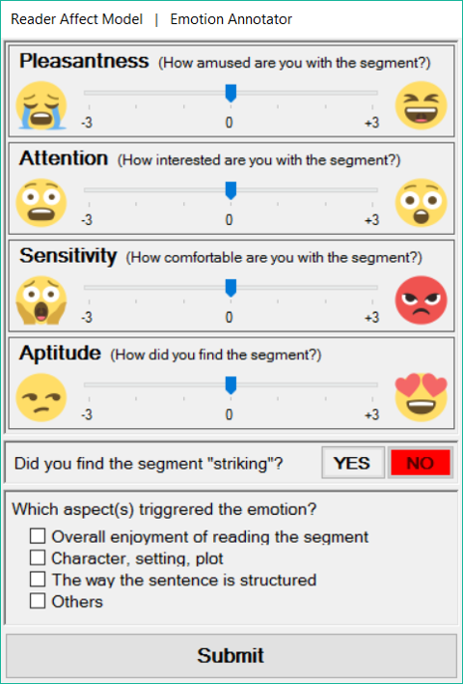
CW | Data Collector Tool
Notes:
Refer to p32. Upper is hourglass of emotions, lower is emotions of literary response

Slide 38
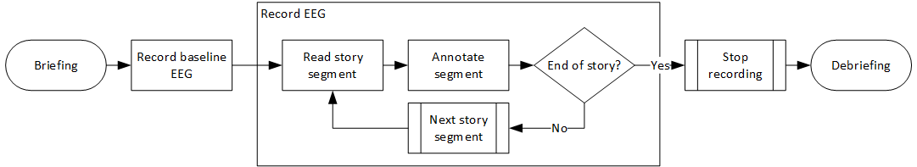
CW | Data Acquisition
Notes:
Refer to P39. Apart from the four EEG studies, the experiment is also patterned after Miall and Kuiken (1994).

Slide 39
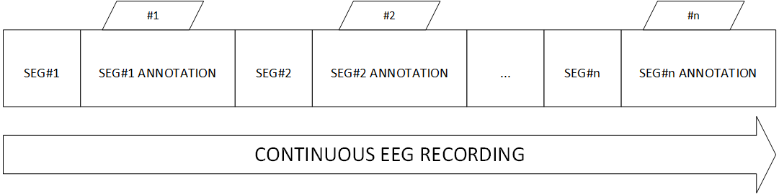
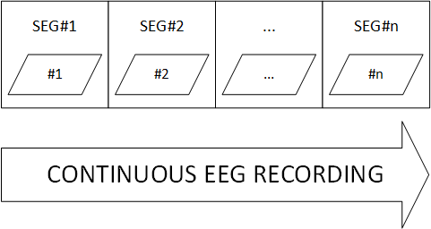
CW | EEG Processing
Notes:
Sync, merge

Slide 40
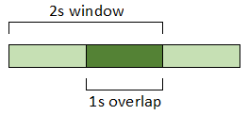
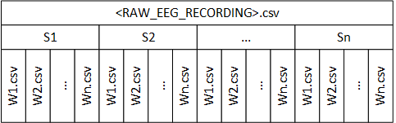
CW | EEG Processing
Notes:
Windowing, resulting files after applying windowing

Slide 41

CW | EEG Processing
Notes:
For each Wn.csv, extract frequency band and features

Slide 42
Thank you for listening!

